Slide 1
Five Number Summary Introduction
Year 11 Mathematics Essentials

Slide 2
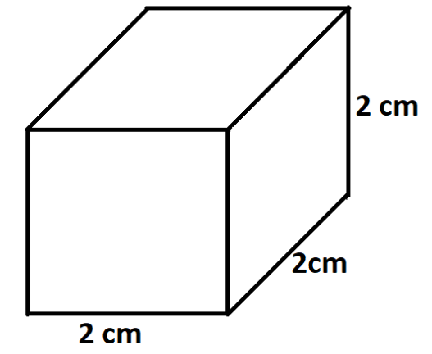
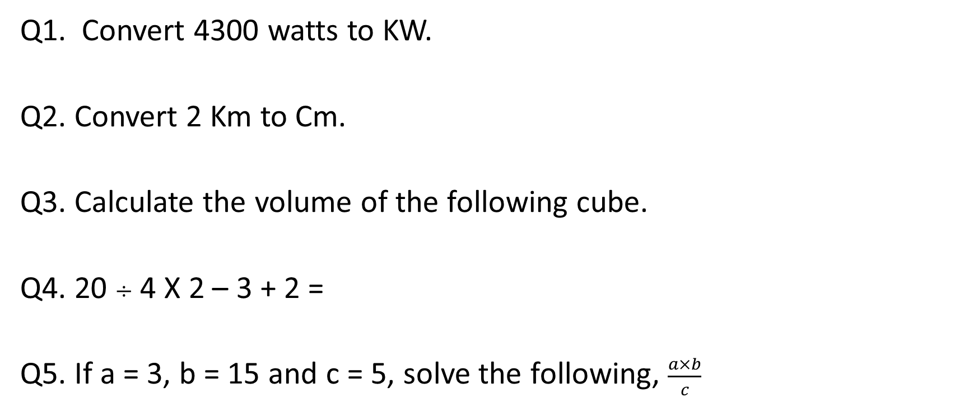
5 questions
Q1. Convert 4300 watts to KW.
Q2. Convert 2 Km to Cm.
Q3. Calculate the volume of the following cube.
Q4. 20 $÷$ 4 X 2 – 3 + 2 =
Q5. If a = 3, b = 15 and c = 5, solve the following, $\frac{a×b}{c}$

Slide 3
24
7
30
Topic: Five Number Summary
Date: /07/2018
EQ – What is the Five Number Summary and how do we display it?
The 5 number summary can be found for any set of numerical discrete data.
The 5 number summary consists of :
The minimum value in a data set (Smallest number)
The 1st quartile/Lower Quartile (Q₁)
The median (2nd quartile) (Middle number)
The 3rd quartile/Upper Quartile (Q₃)
The maximum value in a data set (Biggest number)
What are the 5 number summaries?

Slide 4
24
7
30
Topic: Five Number Summary
Date: /07/2018
EQ – What is the Five Number Summary and how do we display it?
Displaying the 5 Number Summary Visually
We use a Box and Whisker Plot
How do I display the 5 number summary visually?
Lower Quartile
(Q1)
Upper Quartile (Q3)
Lowest Value
Median
Highest Value
Whisker
Box
Whisker
4
5
6
7
8
9
10
11
12

Slide 5
24
7
30
Topic: Five Number Summary
Date: /07/2018
EQ – What is the Five Number Summary and how do we display it?
Analysing a Box and Whisker Plot
How do I analyse a Box and Whisker Plot?
25%
25%
25%
25%
50%
50%

Slide 6
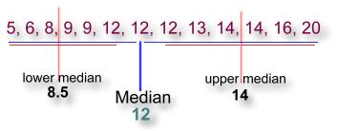
Steps involved
What are the steps that you would take to display the information in a Box and Whisker Plot for this set of data? (Put the data in order first)

Slide 7

Step 1 – Draw a Number Line
Now you are ready to construct the actual box & whisker graph. First you will need to draw an ordinary number line that extends far enough in both directions to include all the numbers in your data:

Slide 8

Step 2 – Draw the Parts
Locate the main median 12 using a vertical line just above your number line:

Slide 9

Step 2 – Draw the Parts
Locate the lower quartile 8.5 and the upper quartile 14 with similar vertical lines:

Slide 10

Step 2 – Draw the Parts
Next, draw a box using the lower and upper median lines as endpoints:

Slide 11

Step 2 – Draw the Parts
Finally, the whiskers extend out to the data's smallest number 5 and largest number 20:

Slide 12
Step 3 - Label the Parts of a Box and Whisker Plot
Lower Quartile
Median
Upper Quartile
Minimum
3
1
2
Maximum
4
5
Name the parts of a Box-and-Whisker Plot

Slide 13


Slide 14
Continue practise questions on page 104

Slide 15
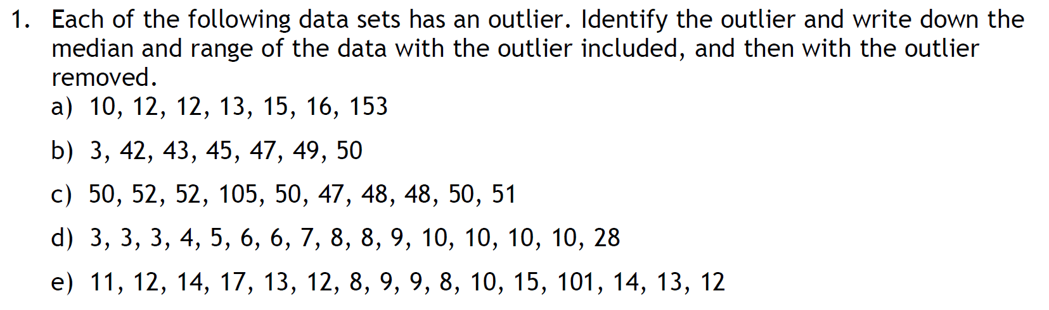
Additional question

Slide 16
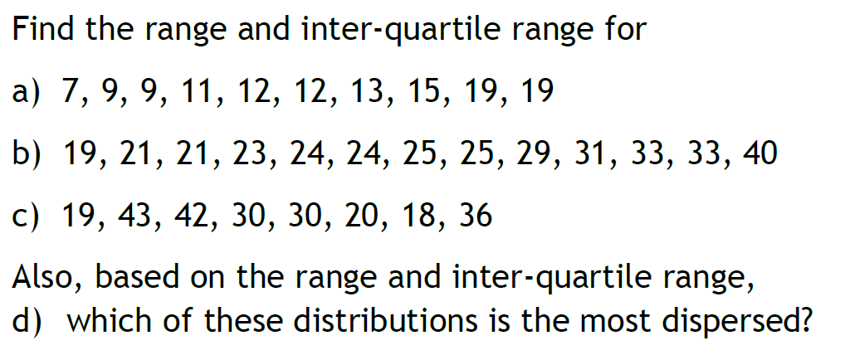
Additional question

Slide 17
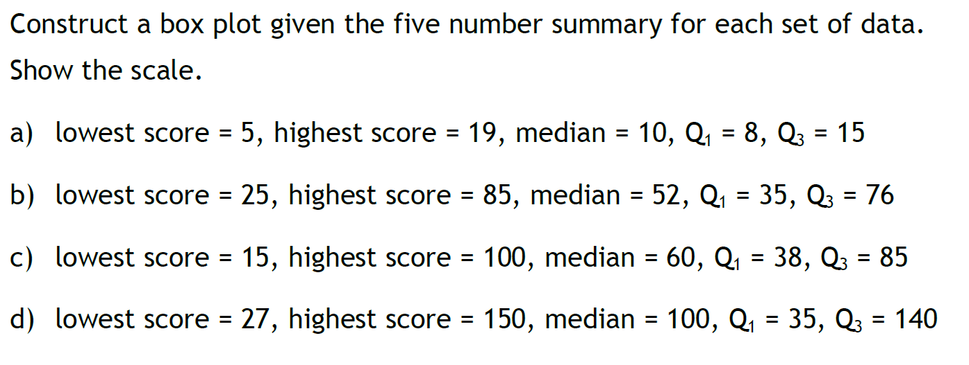
Task

